Slide 1
Banking System Testing

Slide 2
Team Members
23P0251 Lara Sherif Fathy
23P0230 Farida Waleed El Sayed
23P0379 Andrea Aziz Fathy
23P0124 Fady Joseph Guirgis
23P0234 Lina Tamer Yousri
23P0325 Madonna Emad Labib

Slide 3
Black Box Testing

Slide 4
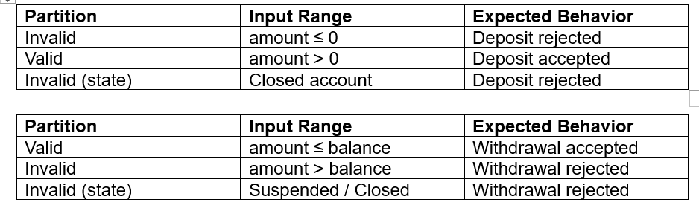
Equivalence Partitioning

Slide 5
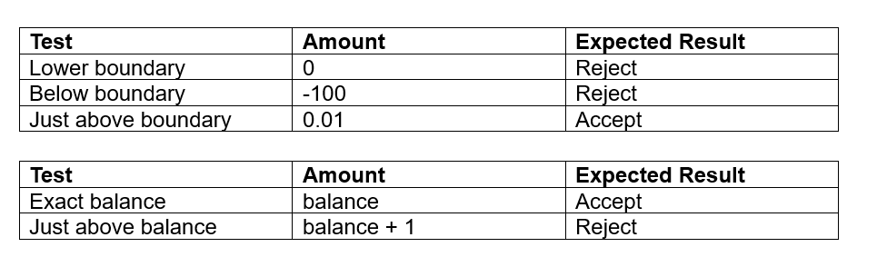
Boundary Value analysis

Slide 6
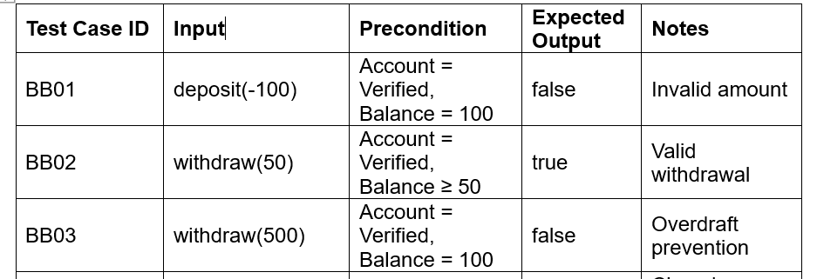
Tested everything matches requirements without depending on implementation
Example tests (Not full table)

Slide 7
White Box Testing

Slide 8
Tested all possible branches for both transactions (withdraw and deposit) and transfers between accounts
Used TransferProcessor and TransactionProcessor

Slide 9
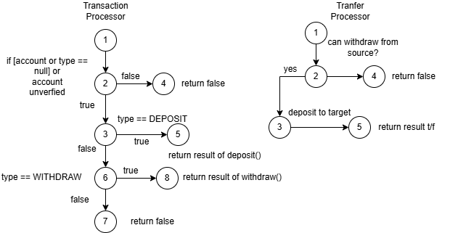
CFGS

Slide 10
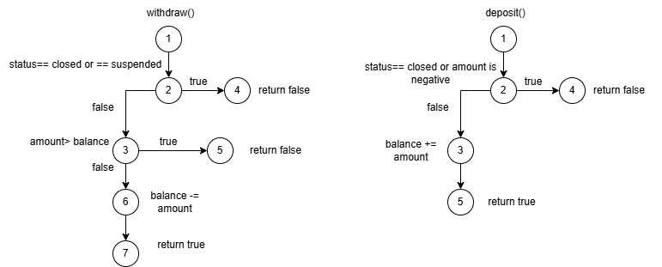
CFGS

Slide 11
UI Testing

Slide 12
Validated input constraints (non-numeric, zero, negative amounts).
Checked button enable/disable behavior based on account state.Verified correct error messages are displayed (e.g., insufficient funds).
Tested both JavaFX GUI logic and HTML dashboard script logic.
Ensured status and balance are rendered correctly.

Slide 13
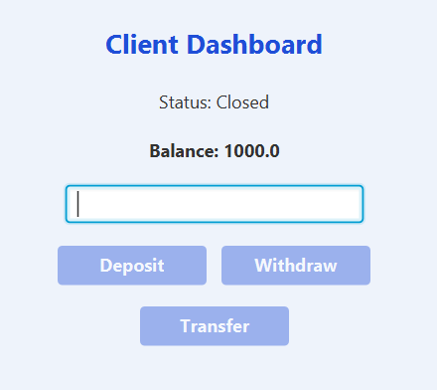
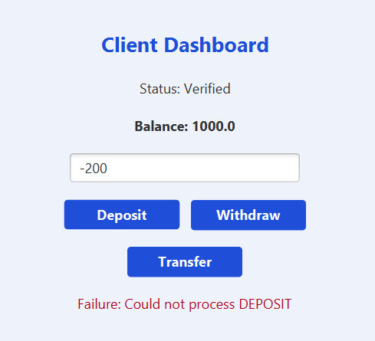
Visual example

Slide 14
State Testing

Slide 15
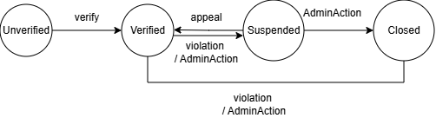
State diagram

Slide 16
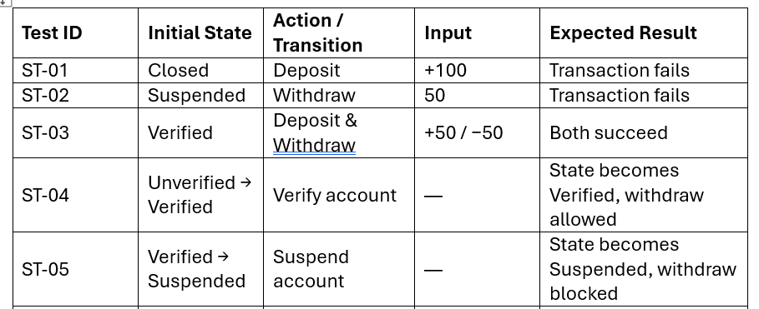
Derived test cases from the account state diagram. And Verified allowed and blocked actions per state and Tested all state transitions
Example (Not all table)

Slide 17
TDD Testing

Slide 18
Designed tests for a new feature (Credit Score Check) before implementation.
Defined expected behavior and boundary conditions upfront.
Implemented minimal code to satisfy failing tests.
Used tests to validate correctness and prevent regressions.
Reflected on improved design clarity and confidence.

Slide 19
Integration Testing

Slide 20
Simulated full user flows from GUI → Controller → Service → Account.
Verified controller responses for deposit, withdraw, and transfer actions.
Tested interaction between multiple accounts during transfer.
Confirmed business rules propagate correctly across layers.Validated user-facing messages returned to the UI.

Slide 21
Thank You

